Slide 1
Around The World In 80 Questions

Slide 2

Introduction Video:

Slide 3
Project Introduction:
This project is about a game which is intended to expand the player’s knowledge in various topics.
Project will include two primary actors: Manager and Player. Manager is able to create new elements or to update old ones. Player is able to perform Activities.

Slide 4
Primary Feature Game Description:
Question will be displayed, the user fills his answer and the game tells him if he was right or wrong.

Slide 5
Vision:
We aim to have a big database of questions and answers in many topics, which can be used for applications and websites easily, we wish to see the program recognised as a good education platform.

Slide 6
Purpose of the system:
The system can be used as a game or a teaching tool, you can add questions and send the question to anyone for them to answer.
Business purpose of the System:
All the features in the games are under license, the game will be licensed yearly by schools.

Slide 7
In Scope:
Out of Scope:
The player can exit the console mid-game.
The system will allow skipping questions.
The system will hold verbal answer based questions in the database
Manager actor will have the ability to add their own questions.
Player will receive points depending on how many correct answers they had.
The system will automatically save the score.
The system will allow payments.
The system will allow advertisements.
The player can select a different language.
The player can add questions.
The system will set timer on every question.
The player can easily customize UI of the service
The game will ask non-verbal questions. (pictures)
The system will return to the point where the player exited.
Player can only answer a question once

Slide 8
Current + Conclusion:
Currently, there are other games of this type on the web, but there is none for educational institutes which can be tailored for the teacher (Manager actor) such as “World Geography Game” for example.
Our competitors (www.quiz-tree.com) are not specific enough for the teacher’s (Manager actor) needs.
For example, adding questions and answers to the database.
In conclusion, there is a need for a platform that can provide education in a fun and interactive way.

Slide 9
Used Technologies:
github
Java Swing
JUnit
Boot Starter Email
Maven
MySQL
AspectJ
Eclipse IDE
Github Repo
Hibernate
JPA
REST API
Spring Boot
Spring Web
Spring Data
JDK 1.8

Slide 10
Actors and goals:
Actor | Primary/Secondary | Description | Goals
Player | Primary | A user that wants to improve their knowledge in history, geography etc. | Improve knowledge, do interactive homework, study for tests.
Manager | Primary/Secondary (depends on the use case) | A user that wants to update questions database or view their player’s performance. | Improve ATW80Q, create more personal experience for players. Review how users use the ATW80Q.

Slide 11
Use Case Diagram

Slide 12
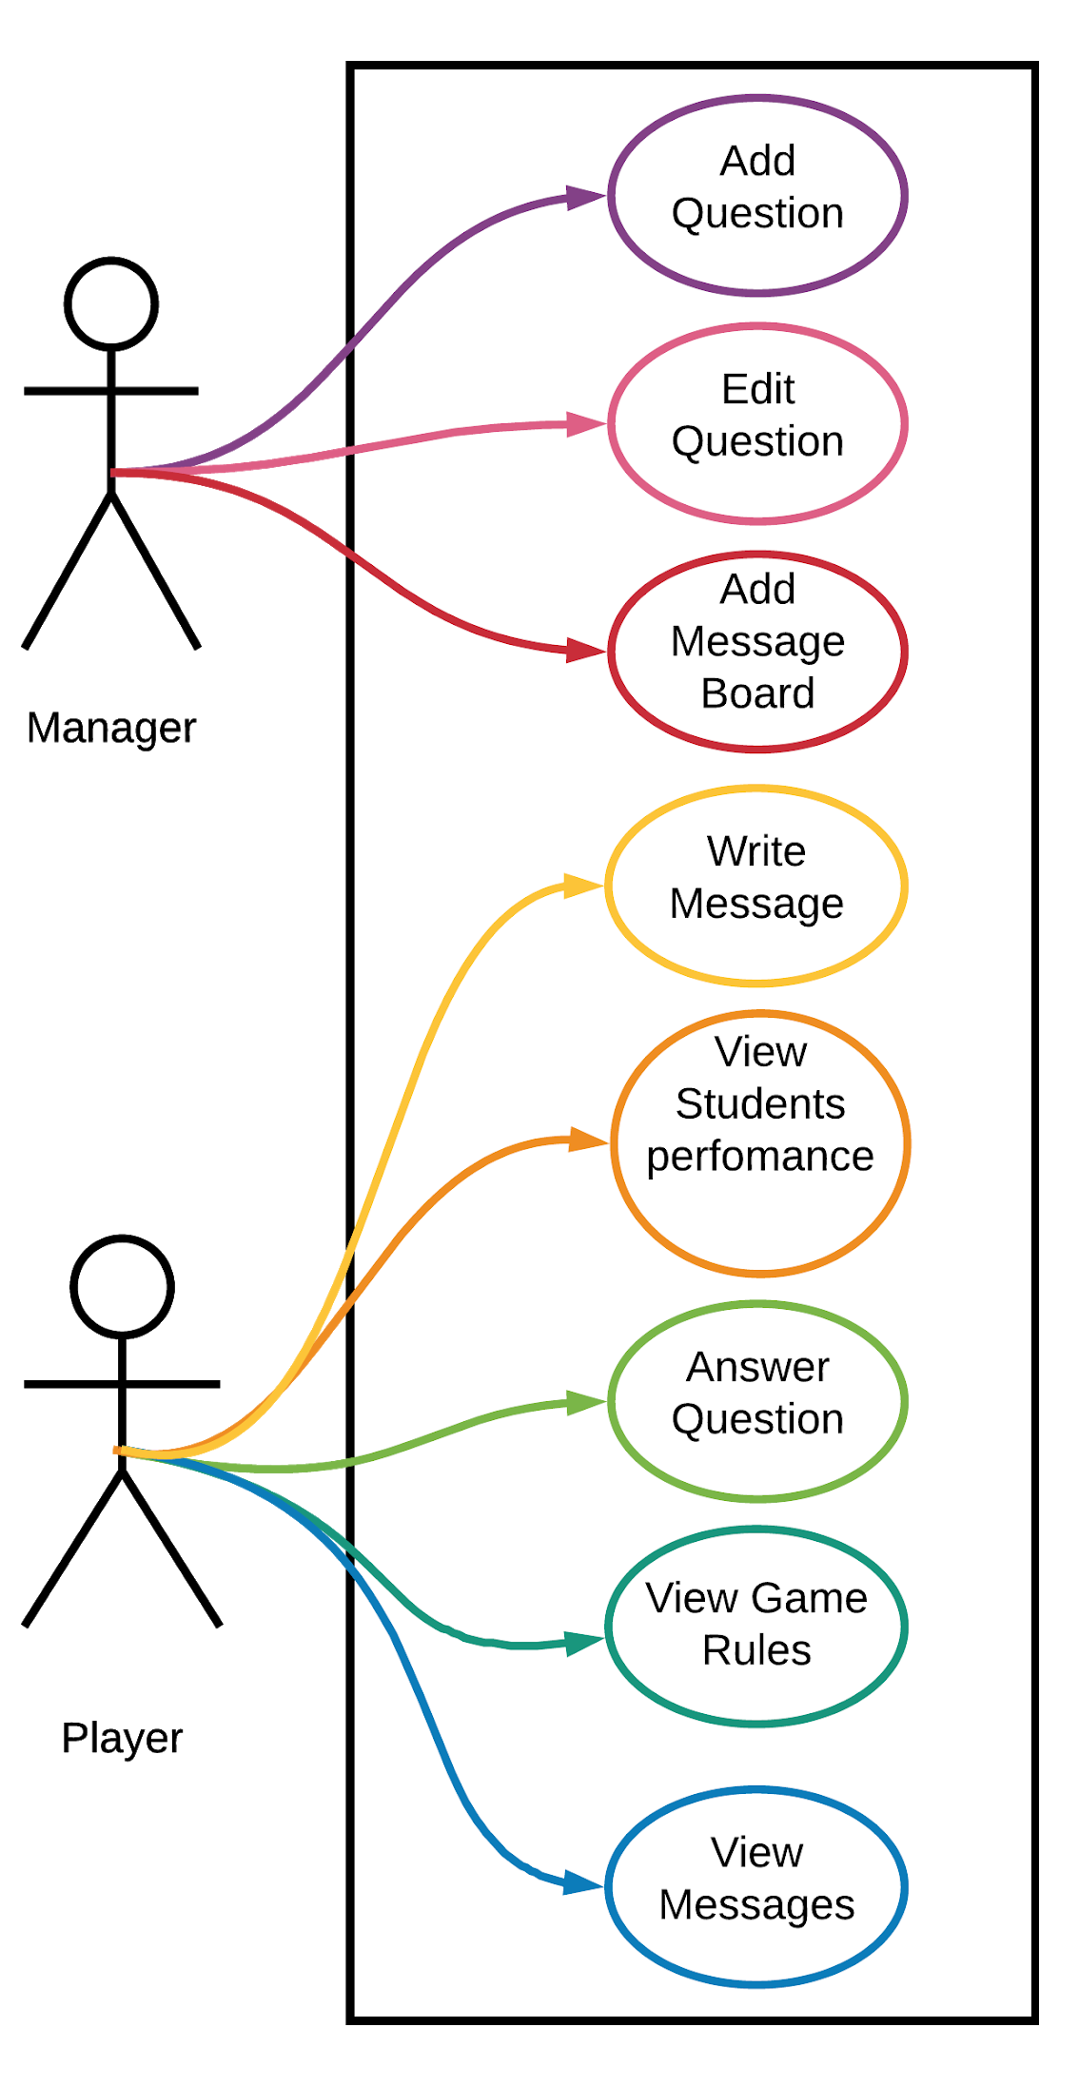

Slide 13
Non functional requirements:
sn | Requirement and Description | Requirement Type (U/R/P/S)
1 | Adding a question will take no more than 3 seconds | FURPS: Performance
2 | The server will be easy to translate to other languages (localizability) | FURPS: Supportability
3 | List of the best players with high score will be limited by pagination from the whole playground | FURPS: Usability
4 | the DataBase in use is MySQL | FURPS: Supportability

Slide 14
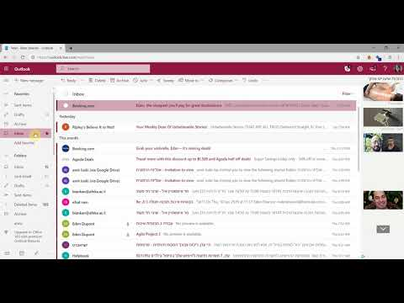
GUI Demo:

Slide 15
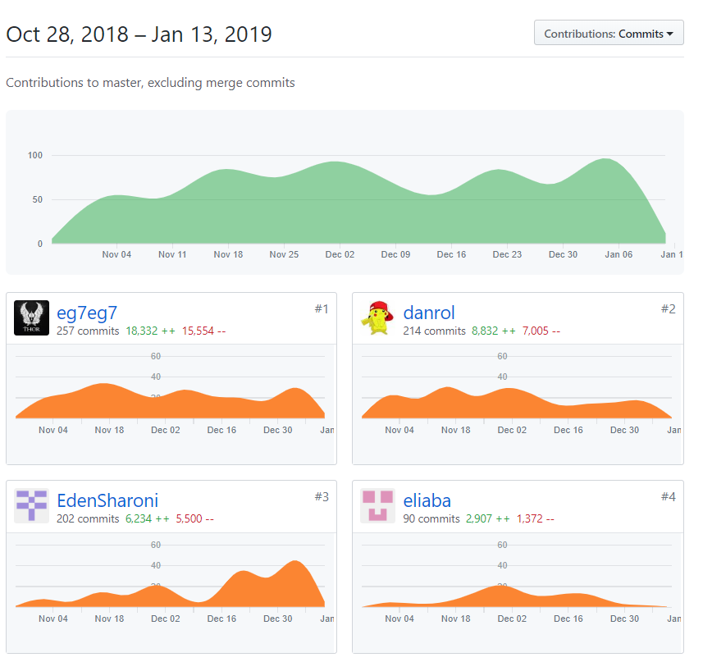
906 Commits in total

Slide 16
Thanks!
Any questions?

